Slide 1

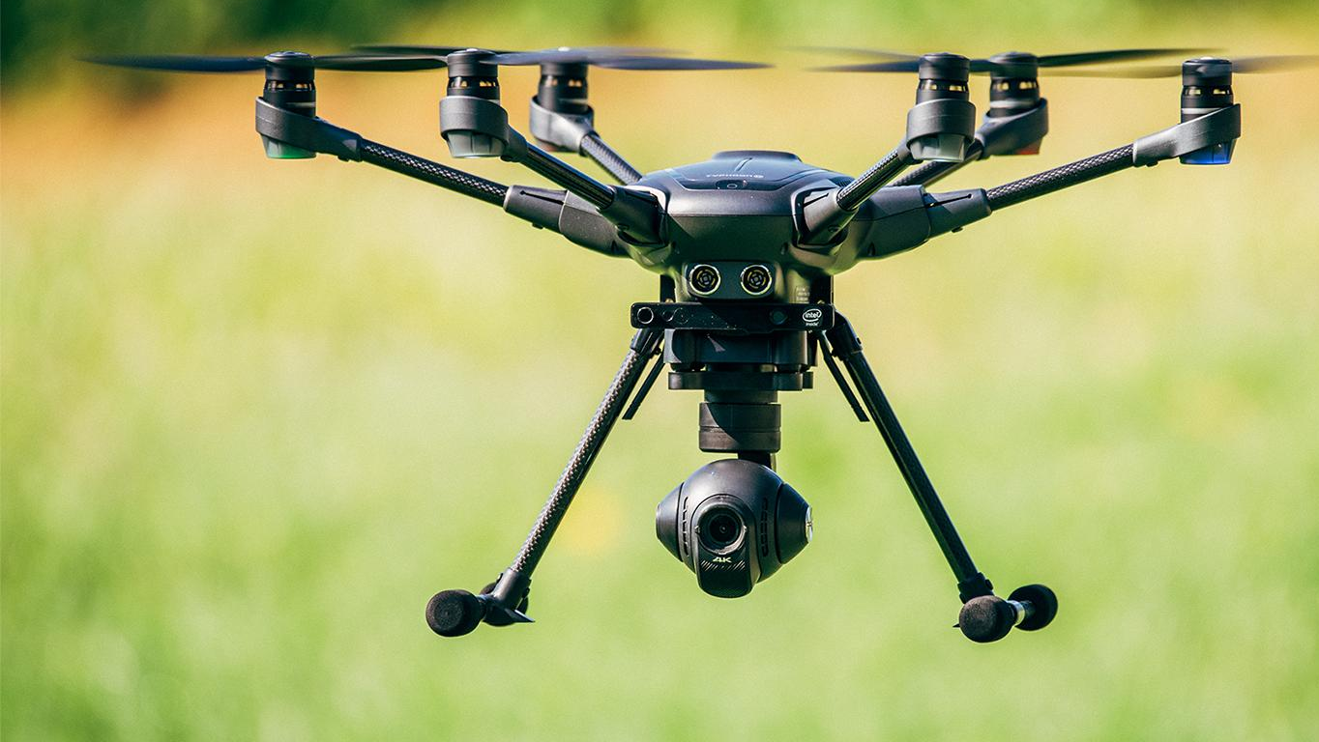
Unmanned Aerial Systems
(UAVs)

Slide 2
What are UASs?
Unmanned aerial systems or (UAV) is an aircraft that can be piloted through a remote device or onboard computer. These vehicles can be automated using predetermined flight paths, or they can be controlled manually using a mobile device or remote control.
How can UASs be utilized in construction?
UAVs conduct site surveys or track project progress in real-time by generating aerial photos, maps, and 3D images. This technology is also helpful for ensuring worksite safety and improving productivity.

Slide 3
UASs utilization in Surveying
You can predict that procurement of this job will require you to have many surveyors with their instruments( transition, total station,..etc) which consumes hours of hard working.
With UAVs technology, each project can be divided into strips ( based on accuracy). These strips are scanned to get information like height, length and type of object in order to produce accurate surveys and contour maps based on high-resolution point cloud data collected from on high.
UASs are connected to GPS, so the you can set your path start/end points and any points in the field accurately to the global coordination. That’s how you can eliminate the error due to the difference between the local coordination and the global coordination.

Slide 4
How UASs improve safety
UAVs are now being used for health and safety inspections, progress reporting and most-prominently in site surveying; capturing accurate data on large areas of land in just a few minutes and accessing potentially hazardous zones with ease, keeping surveyors themselves safe.
Since construction site are a place where many equipment are operating and many laborers are working at the same time. The process of coordinating all of these variables is very complicated.
Drones minimize the stress of managing all of these variables and cut off the time of pre-scripted talk in the site cabin or a pre-recorded video. Using a drone to fly over the site can show new site operatives health and safety risks in real-time, enabling site managers to demonstrate moving vehicles, moving cranes, active excavation areas and so on.

Slide 5
UAVs utilization in work optimization and project progress reports.
While there has been much publicity about the potential for drones to carry out deliveries.
It is the construction industry that is predicted to be the biggest user of commercial drones in the coming years. For example: drones can be use to carry small supplies within the project such as: packs of nails, personal protective equipment (PPE)…etc.

Slide 6
Difficulties that face UAVs technology
Using UAVs techniques mean saving time, man power, eliminating human error, inspection of high hazardous area and collecting more information at once. However, the construction industry lacks of good software platforms and tools that can process such images rapidly and simplify the analytical activity. UAVs-image processing software programs are already simplifying image usability, and vertical-specific software platforms are now adopting the use of such UAV image processing to simplify workflows for solar field professionals. The next two to five years will bring more sophistication to the use of UAVs imagery in construction.

